Slide 1


Presidency
Presidency
School of Artificial Intelligence and Advanced Computing

Slide 2
Unified Security Scanner + RAG Assistant
CSS7102- Mini Project Review-4
Batch Number : CCS_13
Under the Supervision of,
Dr. Sampath A K
Head of the department (cyber security)
School of Computer Science and Engineering
Presidency University
Roll Number | Student Name
20231CCS0117 20231CCS0125 20231CCS0116 20231CCS0173 | Roopashree M Mohammed Rayyan Khan Shreya Syeda Zaiba
Name of the Program: CCS-Computer Science & Engineering (Cyber Security)
Name of the HoD: Dr. Sampath A K
Name of the Program Project Coordinator: Dr . Sampath A K
Name of the School Project Coordinators: Dr. Sampath A K

Slide 3
Content
• Problem Statement
• Drawbacks and Proposed System
• System Architecture
• Modules
• Technology Stack
• Algorithm / Workflow
• Source Code Structure
• Implementation Functionality
• Testing, Results and Discussion
• Conclusion
• References

Slide 4
Problem Statement
• Security analysts often use separate tools for network discovery, template-based vulnerability checks, web application testing, and web-server checks. Managing separate interfaces and outputs makes it harder to review findings consistently.
Key Challenges
• Multiple scanner interfaces and command formats
• Inconsistent finding formats and severity labels
• Manual review of scan results
• Maintaining scan history and generating reports
• Explaining security findings to users

Slide 5
Drawbacks & Proposed System
Drawbacks of a fragmented workflow
• Separate scanner operation and configuration
• Different output formats and command syntax
• Manual comparison and interpretation of findings
• Scans and reports are harder to track centrally
Proposed System — Unified Security Scanner
• Provide one web interface for Nmap, Nuclei, OWASP ZAP, and Nikto.
• Use a FastAPI backend to dispatch scans and normalize findings.
• Store scan history in SQLite and generate PDF reports.
• Use a RAG-based AI assistant with Gemini for security explanations.

Slide 6
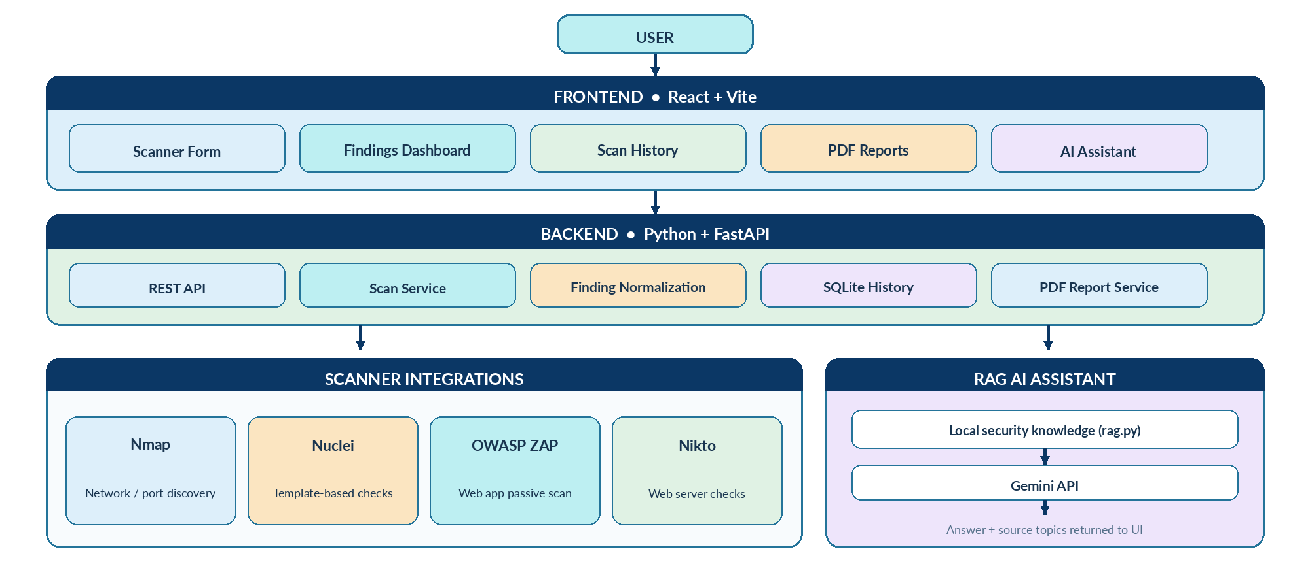
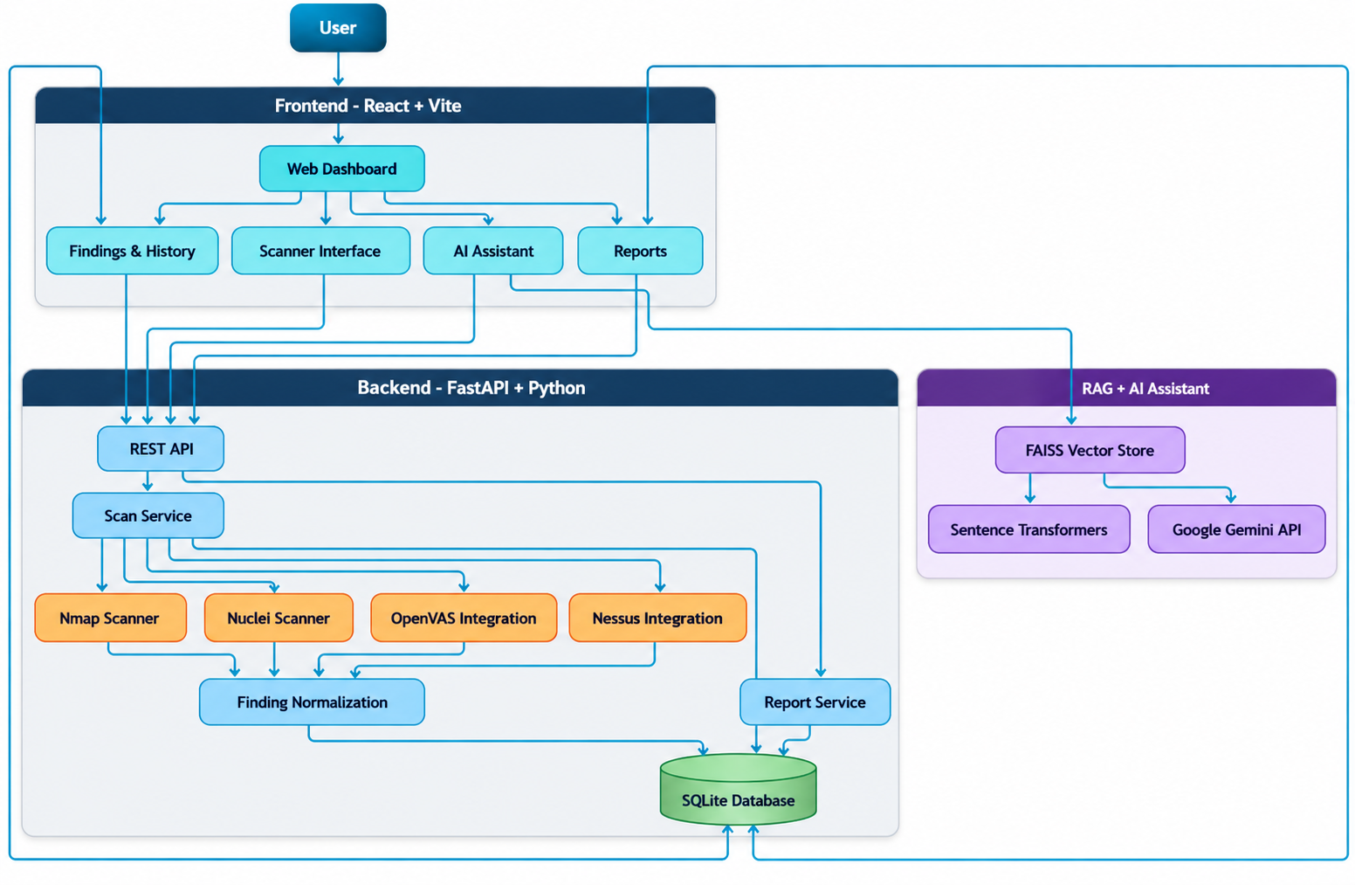
System Architecture

Slide 7
Modules
Module 1 — Frontend (React + Vite)
• Scanner selection and authorized target input
• Findings dashboard with severity and details
• Scan history, PDF reports, and AI Assistant interface
Module 2 — Backend (Python + FastAPI)
• REST API request handling and validation
• Scanner orchestration and common finding structure
• SQLite persistence and report endpoints
Module 3 — RAG AI Assistant
• Retrieve relevant local security knowledge and send context plus question to Gemini

Slide 8
Modules
Module 4 — Scanner Integration
• Nmap — network discovery and port scanning
• Nuclei — template-based vulnerability checks
• OWASP ZAP — web application passive scanning
• Nikto — web-server security checks
Module 5 — Finding Management and Reporting
• Parse scanner output into a common finding format
• Display title, target, severity, description, and available evidence
• Store scan history and make findings available for PDF reporting
• Show clear errors when a scanner or target is unavailable

Slide 9
Technology Stack
LAYER | TECHNOLOGY
Frontend | React.js + Vite
Backend | Python + FastAPI
Database | SQLite
Security Scanners | Nmap, Nuclei, OWASP ZAP, Nikto
AI Assistant | Google Gemini API
RAG Retrieval | Local security knowledge base (rag.py)
Scan History | SQLite-backed scan records
Reporting | PDF report generation
API Communication | REST API
Development | VS Code / Windows

Slide 10
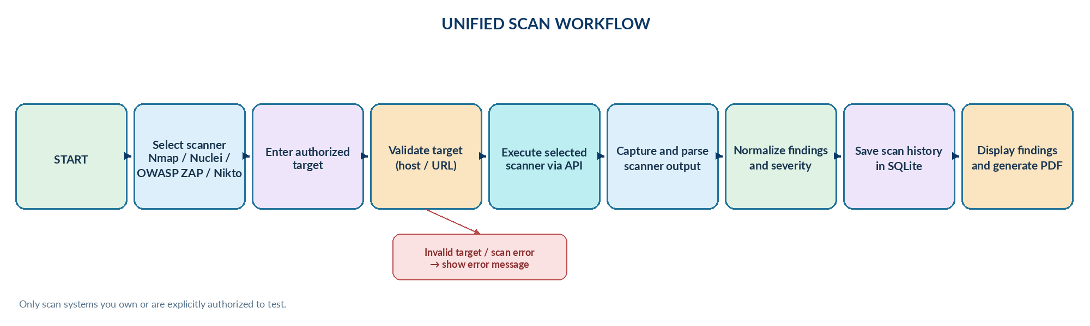
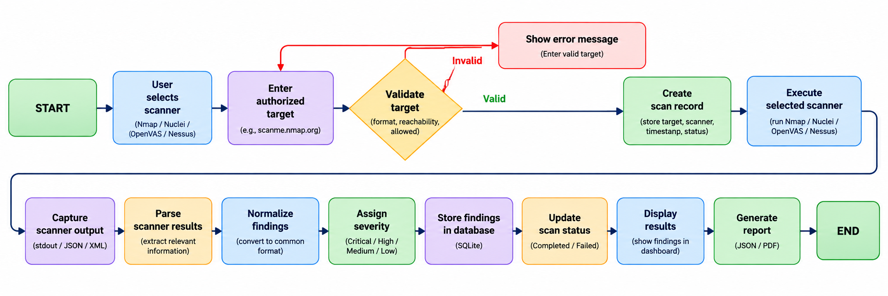
Algorithm 1: Unified Scan Workflow

Slide 11
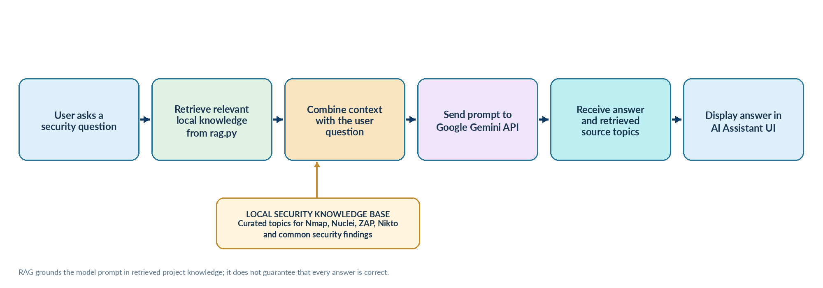
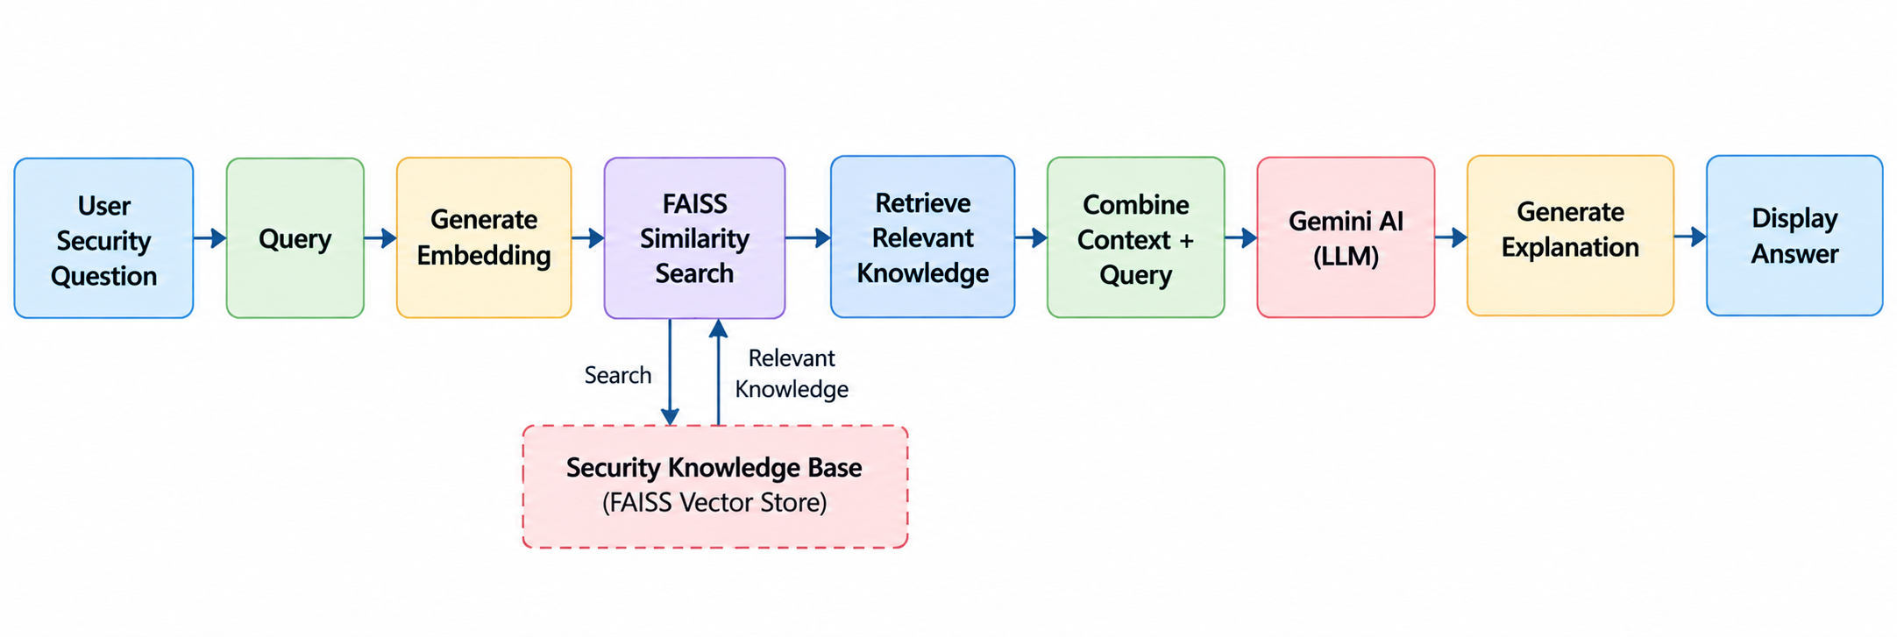
Algorithm 2: RAG + AI Assistant

Slide 12
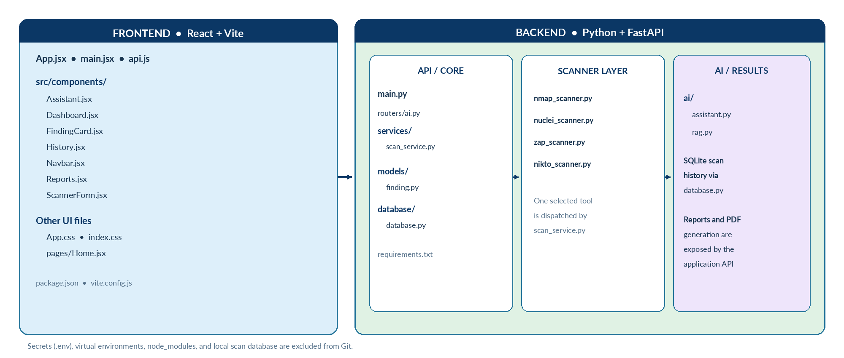
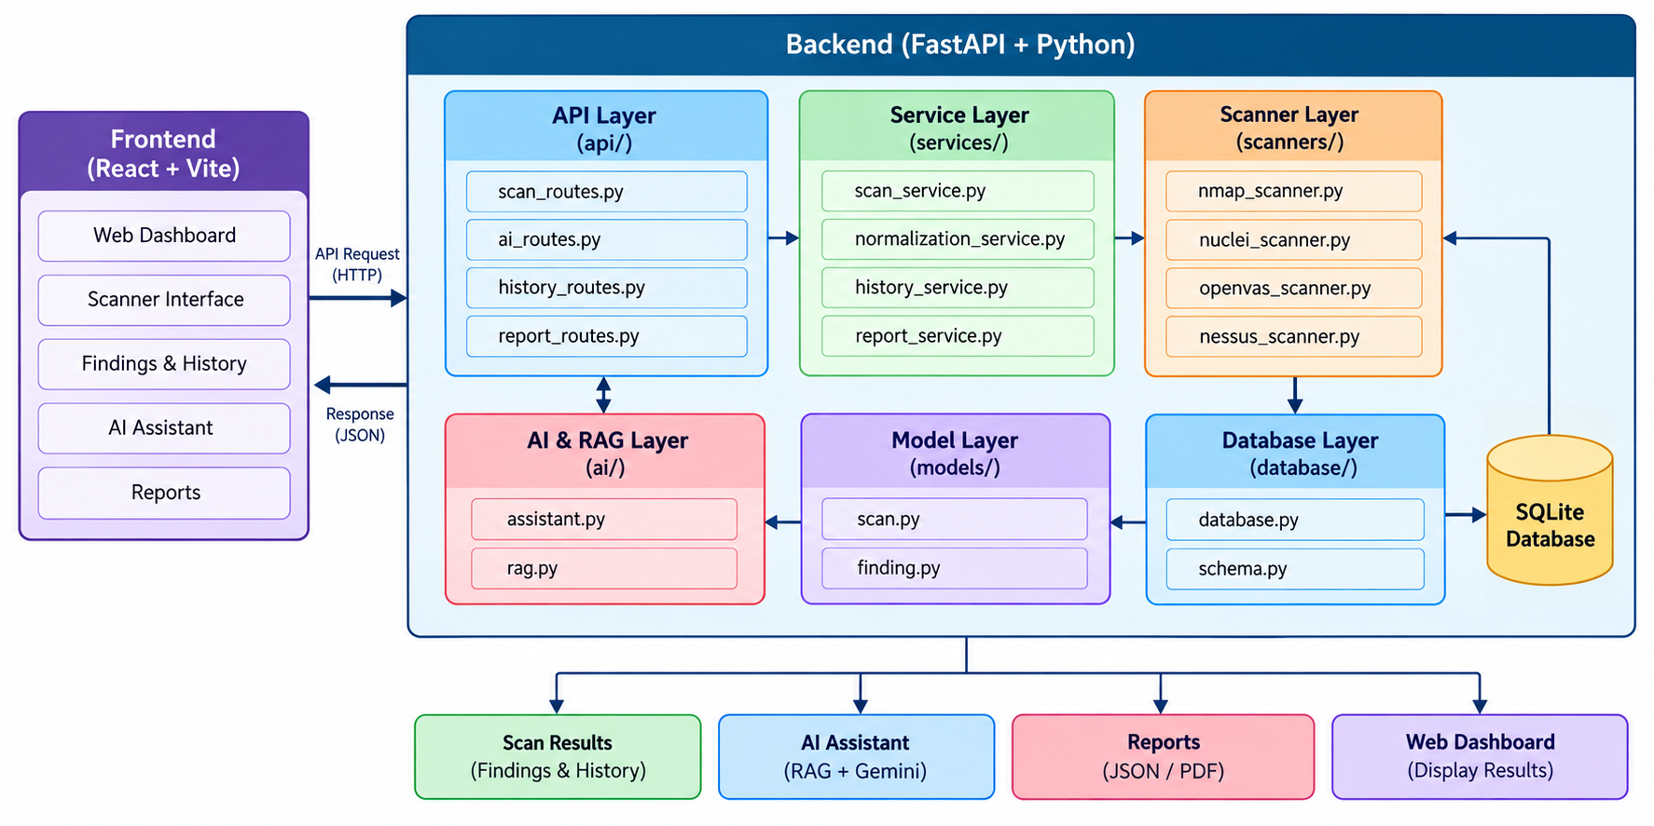
Source Code Structure

Slide 13
Implementation Functionality
Frontend
• React/Vite interface: scanner selection, target input, findings dashboard, scan history, PDF reports, and AI Assistant.
Backend
• FastAPI REST endpoints and scan orchestration; common finding details and SQLite-backed scan history.
Scanner Integrations — all four tested in the local project
• Nmap — network discovery and port scanning
• Nuclei — template-based vulnerability detection
• OWASP ZAP — passive web application security analysis
• Nikto — web-server checks
AI Assistant
• Local RAG knowledge retrieval with Gemini-generated explanations.

Slide 14
Results
Implementation and validation results
• All four scanner integrations were exercised in the local application.
• Findings are displayed in a common interface with severity and descriptions.
• OWASP ZAP successfully reported 7 alerts on the local FastAPI /docs target during testing.
• Scan history and PDF report generation were tested.
• RAG AI Assistant returned answers with retrieved knowledge-source labels.
Build and source checks
• Frontend production build completed successfully (Vite; 24 modules transformed).
• Python syntax compilation succeeded for 17 backend Python files.
• Limitations: scan results may include false positives or miss issues; findings require validation.

Slide 15
Conclusion
• Unified Security Scanner + RAG Assistant provides a centralized interface for running security scans and reviewing findings.
Key Contributions
• Four integrated scanners: Nmap, Nuclei, OWASP ZAP, and Nikto.
• Centralized findings, severity display, and scan history.
• PDF reports for documenting scan results.
• RAG + Gemini assistant for security explanations grounded in retrieved project knowledge.
• Extensible design for future scanner integrations and stronger validation.
• Security note: use only on systems with permission; manually validate findings.

Slide 16
References
1. Automation of Nmap Scanning of Information Systems
https://ieeexplore.ieee.org/document/10496014
2. Web-based Reconnaissance and Vulnerability Scanner: A Review and Proposed Solution
https://ieeexplore.ieee.org/document/9655963
3. A Comprehensive Detection Approach of Nmap: Principles, Rules and Experiments
https://ieeexplore.ieee.org/document/9329410
4. Evaluation of Security Vulnerability Scanners for Small and Medium Enterprises Business Networks Resilience Towards Risk Assessment
https://ieeexplore.ieee.org/document/8873438
5. Research on the LLM-Driven Vulnerability Detection System Using LProtector
https://ieeexplore.ieee.org/document/10859408
6. Enriching IP Scanning Results with Structured Threat Intelligence Toward Actionable Reconnaissance in Cybersecurity Operations
https://ieeexplore.ieee.org/document/11208493
7. Vulnerability Management Chaining: An Integrated Framework for Efficient Cybersecurity Risk Prioritization
https://ieeexplore.ieee.org/document/3665768
8. IoT-Scan: Network Reconnaissance for Internet of Things
https://ieeexplore.ieee.org/document/10299538
9. A Comparative Analysis of Port Scanning Tool Efficacy
https://ieeexplore.ieee.org/document/10339885
10. RAGSec: Retrieval-Augmented Generation for Cybersecurity Threat Intelligence in Enterprise Networks
https://doi.org/10.1109/ICAIC67076.2026.11395762

Slide 17


